Slide 1
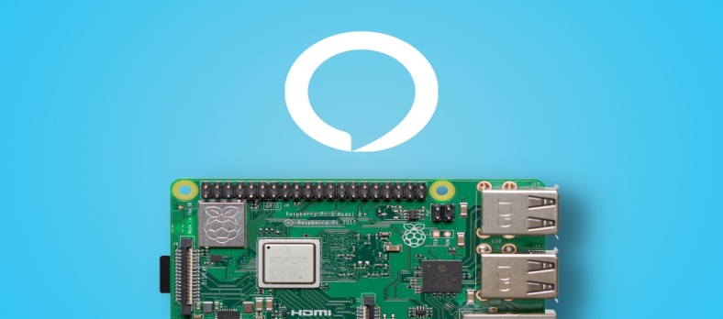
SMART HOME ASSISTANT WITH AMAZON ALEXA
TEAM NAME:MIND BENDERS
TEAM MEMBERS:
CH.SANDEEP KUMAR
CH.SAI KRISHNA
D.AKSHITHA

Slide 2
ABSTRACT:
The main objective of this project is to reduce work load for the people and save energy. Alexa can also control several smart devices using itself as a home automation system .Most devices with alexa allow users to activate the devices using a wake-word. Currently, interaction and communication with alexa are avaiable only in English, french, german, spainsh and Japanese.

Slide 3
Agenda
Introduction
Block diagram
Circuit diagram
PUBNUB & IFTTT
Applications

Slide 4
BLOCK DIAGRAM :
HUMAN VOICE
USB
MICROPHONE
Raspberry
PI
IFTTT
SPEAKER
LIGHT IS
ON/OFF

Slide 5
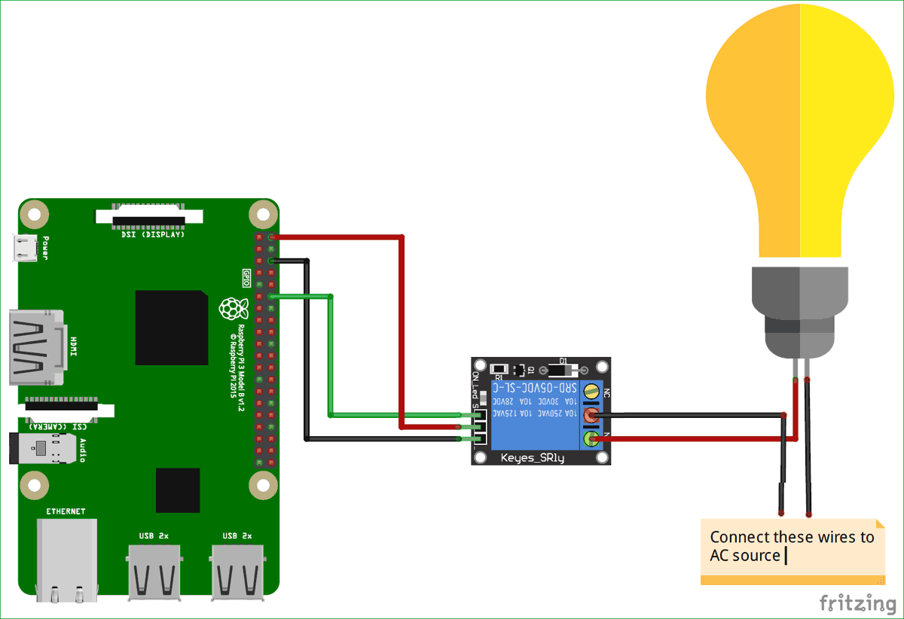
CIRCUIT DIAGRAM

Slide 6
CREATING PUBNUB KEYS
PUB NUB is a global Data Stream Network (DSN) and real-time infrastructure-as-a-service (IAAS) company based in San Francisco, California. The company makes products for software and hardware developers to build Real time web, mobile, and Internet of Things (IOT) applications.
By logging in to pub nub account we will get publish, subscribe key. Save those keys for the future uses

Slide 7
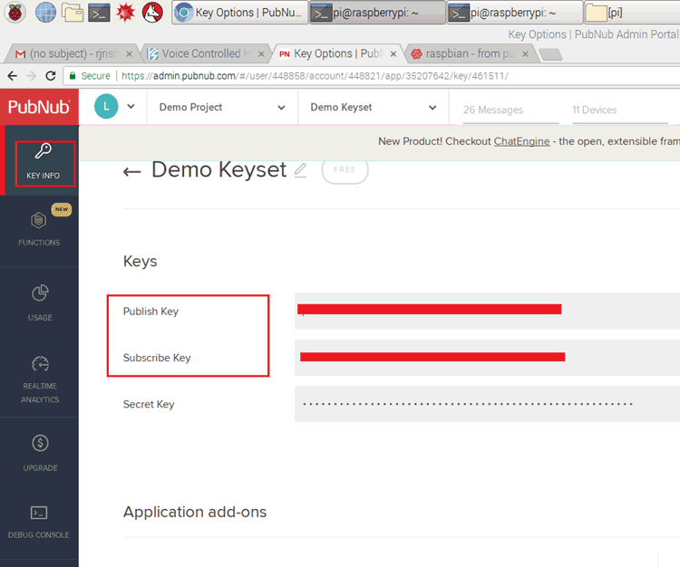

Slide 8
CREATING IFTTt APPLETS
If This Then That, also known as IFTTT is a free web-based service to create chains of simple conditional statements, called applets.
An applet is triggered by changes that occur within other web services such as Gmail, Face book, Telegram, Instagram or pinterest
For example, an applet may send an e-mail message if the user tweets using a hashtag, or copy a photo on Facebook to a user's archive if someone tags a user in a photo.
We should login to IFTTT with our credentials and create new applet by selecting the web service as alexa and the we have to provide phrases like turn on light (or) turn off light. At the end we will get a URL.

Slide 9
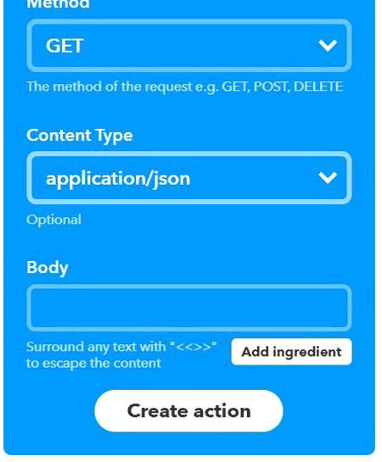
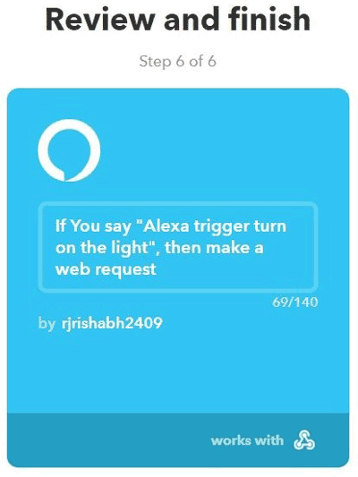
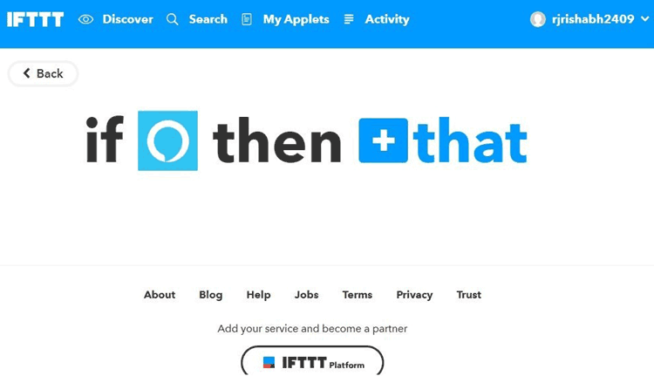

Slide 10
HARDWARE COMPONENTS:
RASPBERRYPI : It is a credit-card sized computer that plugs into a monitor and uses standard keyboard and mouse.
BASIC SHEILD : The basic shelid is an input/output expansion shield designed for use with a micro controller board.
USB MICROPHONE : It is a easy way of making high quality recordings, you can listen directly to the sound through headphones.

Slide 11
SOFTWARE/WEBSITES :
ALEXA : Alexa is smart assistant that listen to, and respond to vioce commands, giving you answers.
PYTHON : Python is a good programming language for beginners. It is a higher level language, which means a programmers can focus on what to do instated of how to do.
PUBNUB(ONLINE) : Pubnub is an online document-creation system, it is easy to write and publishing documents

Slide 12
APPLICATIONS
Play radio stations.
Set timers and alarms.
Controlling smart home devices with your voices.

